Slide 1
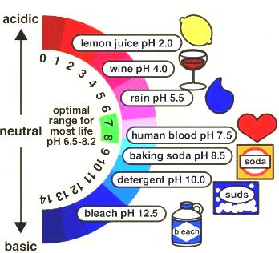
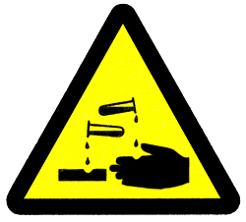
Reactions Involving Acids and Bases
Notes:
Now, we can look at another type of specific reactions involving acids and bases.

Slide 2
Arrhenius Definition
Acids: any substance that produces hydrogen ions in solution
Bases: any substance that produces hydroxide ions in solution

Slide 3
As part of your homework:
Review acids and bases in the text and be able to define strong vs weak acids and bases

Slide 4


Producing Acids & Bases
need H⁺_{(aq)} or OH⁻_{(aq)} to be readily available
and capable of interacting with other chemicals
Their reactivity often makes them difficult to store so we need methods of producing these
H₂O
Notes:
The first surprise is that production of acids and bases is actually trickier than people realize. But think about, it they are soluble and highly reactive.
In order to have an acid or a base we need aqueous H⁺ or aqueous OH⁻ to be readily available
and capable of interacting freely with other chemicals
which means they can’t just stored very long as they would interact with their surroundings and would no longer be available.
so they must be easily produced as needed
Which means we need a plentiful source that does not produce these ions too easily or else it won’t persist until we need to change it.
The chemical that is ideal is water. Plentiful, stable and contains both H⁺ and OH⁻
Now our next task is to remove the ions from the water molecule.

Slide 5
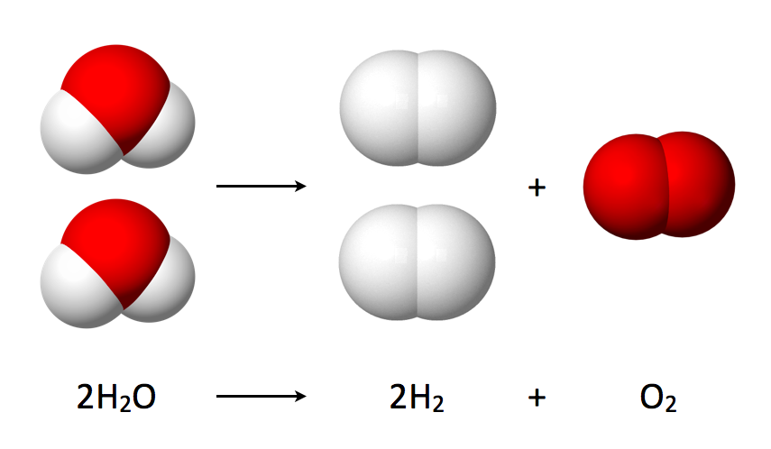
Producing Acids & Bases
need something strong enough to break H₂O or HOH into H⁺_{(aq)} or OH⁻_{(aq)}
but it can’t be too reactive to ensure it persists
and it can only allow either H⁺_{(aq)} or OH⁻ _{(aq)} to continue to exist or the result is still neutral
the answer = OXIDES
incredibly stable but contains reactive oxygen, O²⁻
Notes:
So how our task is
to find something strong enough to break H₂O into free aquesous H⁺ and OH⁻
but another challenge is that this other chemical can’t be too reactive on its own or it won’t persist until we need it
and still one more challenge is that in the end, this other chemical must ensure that only one of either H⁺ or OH⁻ continues to exist or the result would still be neutral water as there would be equal amounts of acid and base present.
the molecules that serve these goals are the oxides
They are incredibly stable but contain a reactive oxide ion which is capable of breaking water apart

Slide 6
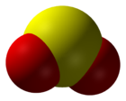
Non-metal Oxides
are covalent molecules such as SO_{2(g)} or CO_{2(g)}
react directly with water as a synthesis reaction
e.g. SO_{2(g)} + H₂O_{(l)} ➔ H₂SO_{3(aq)} or H₂SO_{2(aq)}, etc.
non-metal oxides + water ➔ ACIDS
Notes:
Lets look at the non-metal oxides first.
These are covalent molecules such as sulfur dioxide or carbon dioxide
these molecules react directly with water as a synthesis reaction; that is, they produce one soluble product
for example sulfur dioxide does not just dissolve in water, but breaks apart the water chemically and strongly bonds covalently to the OH⁻_{(aq)} while the H⁺_{(aq)} only associates with the negative polyatomic ion formed. The actual product formed depends on reaction conditions which is beyond the scope of our course, so all you must do is ensure that the product is proper according to nomenclature rules. The equation can always be balanced but you can’t make up brand new compounds.
And so, the OH⁻_{(aq)} from the water breakdown has been removed while the H⁺_{(aq)} remains free. So non-metal oxides react with water to produce acids.
Generally, the more non-metallic the non-metal, the more acidic the acid formed because it is the non-metal in the oxide that rips the water apart.
Also, the more soluble the non-metal oxide, the more acidic as this will allow more of it to interact with water.

Slide 7
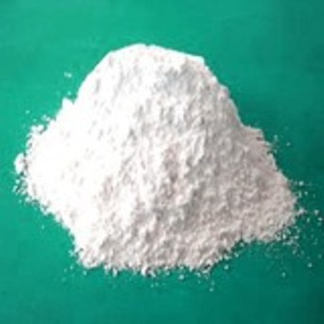
Metal Oxides
mostly ionic, e.g. MgO_{(g)} which dissolve in H₂O_{(l)}
so overall: MgO_{(g)} + H₂O_{(l)} ➔ Mg²⁺_{(aq)} + 2 OH⁻_{(aq)}
metal oxides + water ➔ BASES
Notes:
Ok, logically, metal oxides are the opposite. But they react differently.
Metal oxides tend to be ionic so they readily dissolve in water
but they do so as separate ions; that is the metal oxide simply splits into free ions in water.
This is actually just the physical change of dissolving the salt in water.
However, this immediately liberates the oxide ion which is now capable of attacking and breaking water apart. This releases OH⁻_{(aq)} while the H⁺_{(aq)} from the water covalently bonds to the O²⁻_{(aq)} from the oxide to create a second OH⁻_{(aq)}.
This is a chemical change because there has been bond destruction and bond creation.
So in reality this a two step process but we only focus on the overall reaction.
And in the end, we see that metal oxides react with water to generate bases.
Generally, the more metallic the metal, the more basic the base formed because more of the oxide ion is readily freed from the ionic compound which means it is better able to rip the water apart.
Also, the more soluble the metal oxide, the more basic as this will allow more of it to interact with water.

Slide 8
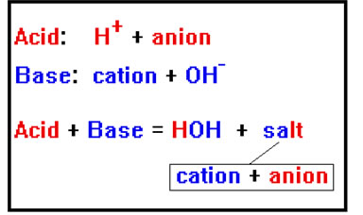
Neutralization
is a double displace reaction
in which the acidic and basic properties cancel each other
e.g. HCl_{(aq)} + NaOH_{(aq)} ➔ NaCl_{(aq)} + H₂O_{(l)}
recall, the net ionic equation clearly indicated the neutralization reaction
H⁺_{(aq)} + OH⁻_{(aq)} ➔ H₂O_{(l)}
Notes:
Finally, the last type of acid base reaction is the neutralization reaction which we already investigated under types of reactions and ionic equations.
As this is a specific type of double displace reaction
in which the properties of the acid and the base cancel each other
as the H+ and OH- are used to create water as seen in this example.
and this neutralization can better be understood through the net ionic equation
showing that the H+ from the acid is cancelled by the OH- from the base generating neutral water, assuming equal amounts of each of these ions are reacted.

Slide 9
Carbonate Neutralization
carbonates react with acids producing carbonic acid and a salt
e.g. 2 HNO_{3(aq)} + Na₂CO_{3(aq)} ➔ H₂CO_{3(aq)} + NaCl_{(aq)}
but carbonic acid is not stable in water so it immediately decomposes
so H₂CO_{3(aq)} ➔ CO_{2(g)} + H₂O_{(l)}
2 HNO_{3(aq)} + Na₂CO_{3(aq)} ➔ CO_{2(g)} + H₂O_{(l)} + NaCl_{(aq)}
Notes:
An interesting twist to this involves using carbonates to neutralize acids.
anytime a carbonate salt is reacted with an acid, a new salt is produced along with carbonic acid
for example look at the reaction of nitric acid with sodium carbonate to produce carbonic acid and sodium chloride
but the carbonic acid is highly unstable in water and immediately undergoes decomposition
into carbon dioxide and water
so the real reaction is seen as the overall combination of these two reactions. In fact, the carbonic acid decomposition is so immediate, we only write the final reaction as this is what really happens. This raises one final point, there is actually quite a few ways to neutralize any acid or base as long as in the end the hydrogen ions or hydroxide ions have been removed from the solution.

Slide 10
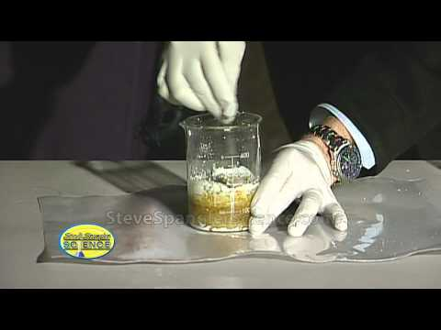

Slide 11
THE END

Slide 12
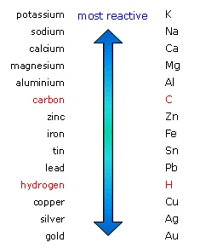
Reactive Metals
a single displacement reaction
a metal more reactive than hydrogen
displaces one H in H₂O_{(l)}
to directly create a BASE and hydrogen gas
e.g. 2 Na_{(s)} + 2 H₂O_{(l)} ➔ 2 NaOH_{(aq)} + H_{2(g)}
note that 2 NaOH_{(aq)} is really 2 Na⁺_{(aq)} + 2 OH⁻_{(aq)}
Notes:
There are other methods that can be used to generate acids or bases. For example, reactions involving reactive metals.
relying on single displacement reactions
involving metals that are more reactant than hydrogen
which means the metal can displace H in compounds, but here it is only strong enough to displace 1 H in water
to directly create a base because the displaced hydrogen becomes diatomic hydrogen gas.
For example, consider the reaction in which raw sodium metal is added to water to produce sodium hydroxide, and hydrogen gas
and don’t forget sodium hydroxide is ionic so it is really free aqueous sodium ions and free aqueous hydroxide or base ions

Slide 13

Double Displacement
a double displace reaction
can be used to generate stronger acids
as long as unwanted ions are locked in
e.g. 2 HI_{(aq)} + Pb(NO₃)_{2(aq)} ➔ 2 HNO_{3(aq)} + PbI_{2(s)}
Notes:
Certain reactions can change one acid into another one.
typically this involves a double displace reaction
which can actually be used to convert one acid into a stronger acid
but there must be a way to lock in some of the unwanted ions.
As we can see in this example when a weaker acid is converted to a very strong acid through double displacement with the production of solid lead(II) iodide.

